Slide 1
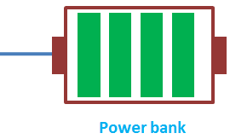
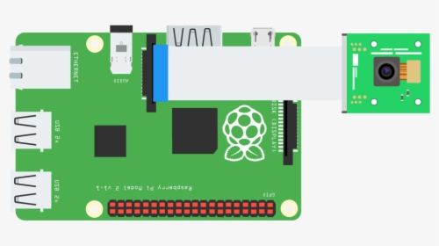
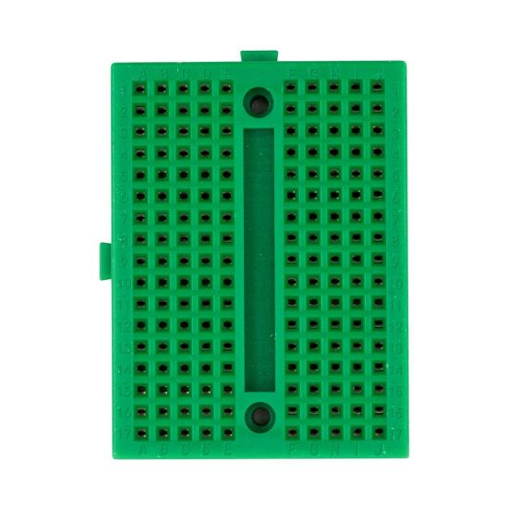

Hardware for Image Processing & Barcode Scanning
CAMERA
MODULE V2
Raspberry Pi 4
Breadboard
ESP8266 V2

Slide 2

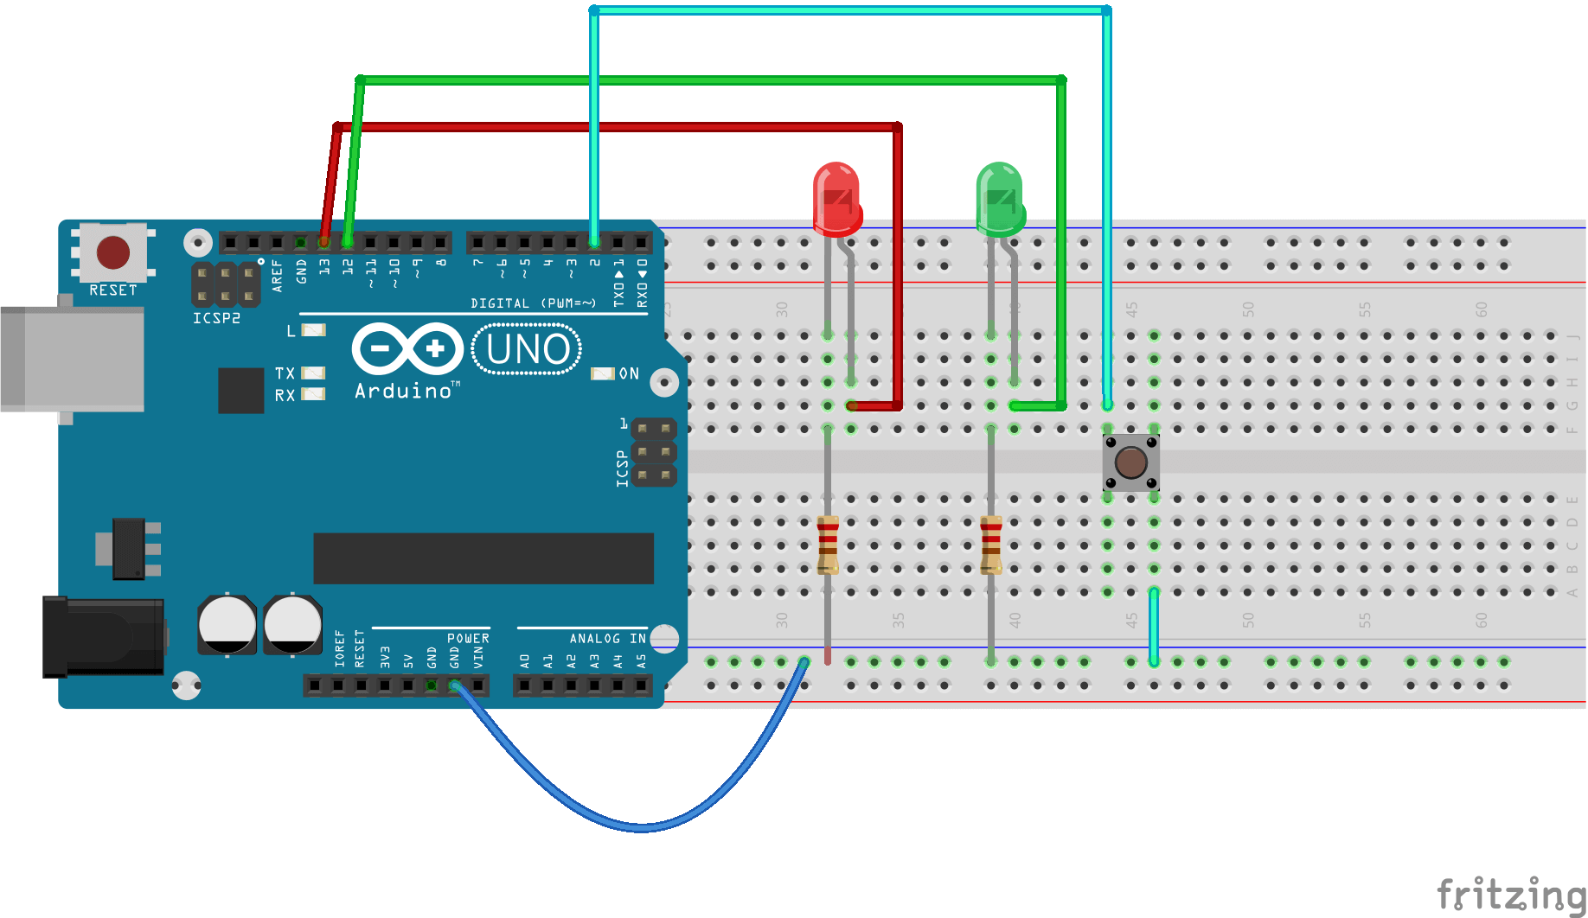

Buzzer
Hardware for Security System
Red & Green LED
Arduino UNO
ESP8266 V2

